Slide 1
March 20 Update
UH OH

Slide 2
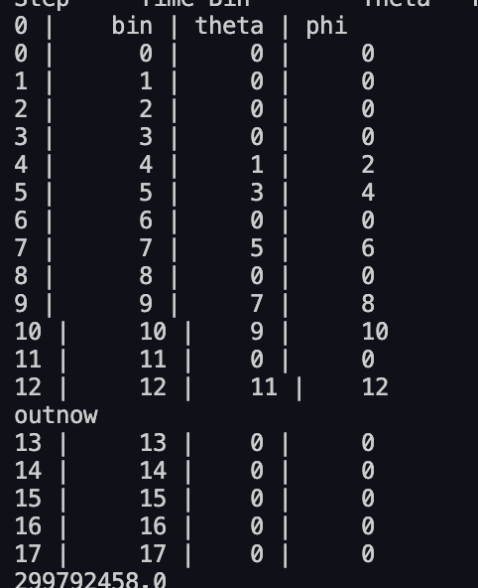
- Table is done! She’s ugly! (she’s beautiful to me) -> - ill make it prettier but that’s a later problem - phases are arbitrary rn (they’re the same as the mesh at the start of them sem this is just for demo purposes) - I've also denoted the pi shifts as 0s for now… - Figured out how many timebin lengths each mode goes thru - Figured out how many mzis each mode goes thru these are both found automatically in the code/ just… general
What I’ve been up to

